Slide 1

CSE 3121
Database Management Systems
Session: 2016-17
Dr. Asif Zaman
Associate Professor, CSE, RU
Week # 1

Slide 2
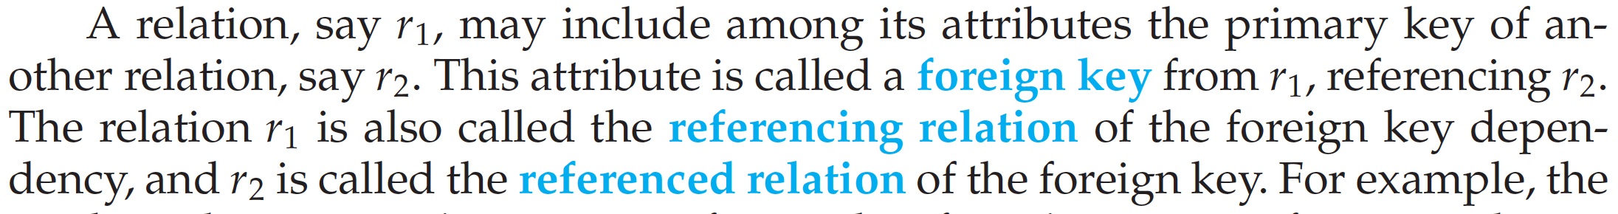
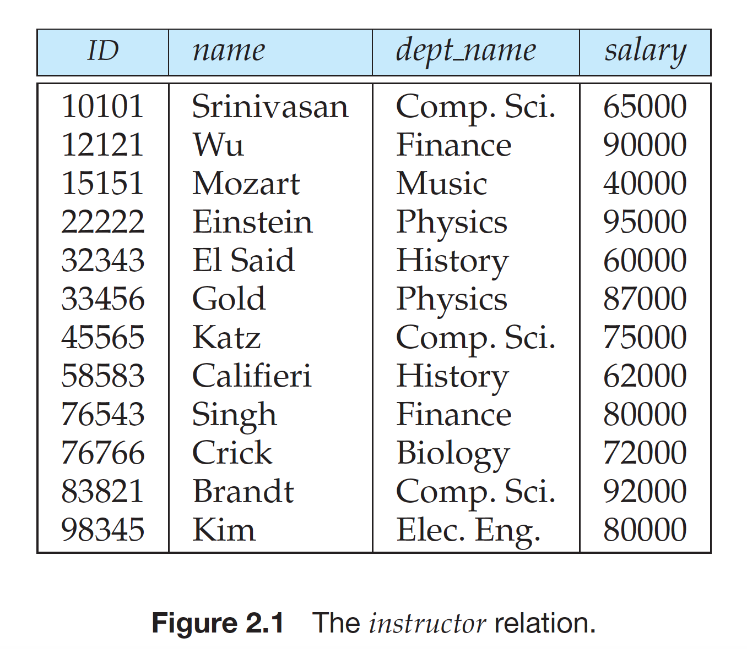
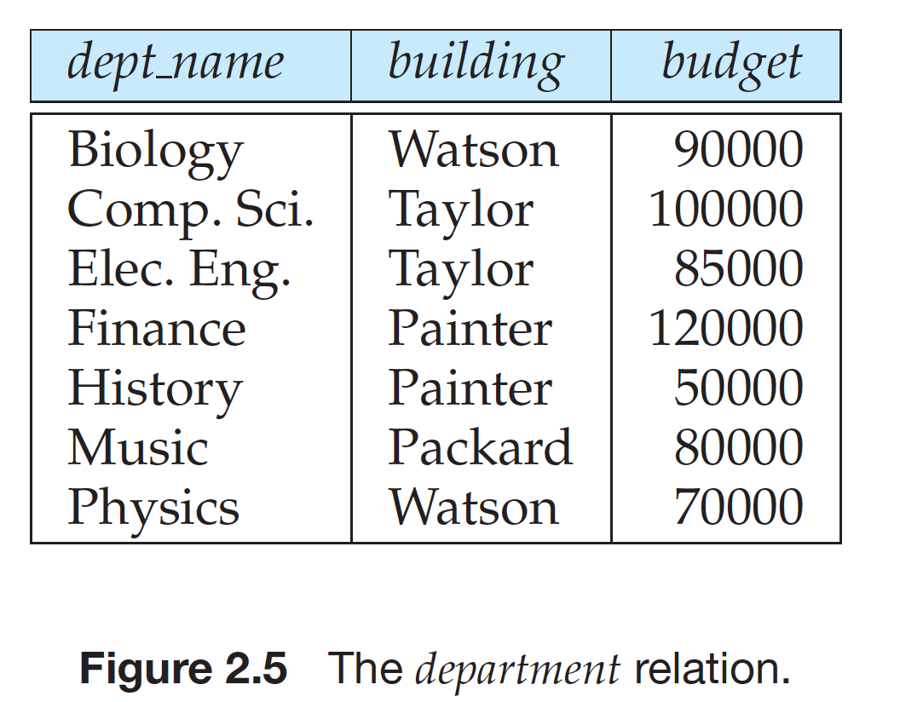
Relational Model: Foreign Key
Foreign Key Constraints

Slide 3
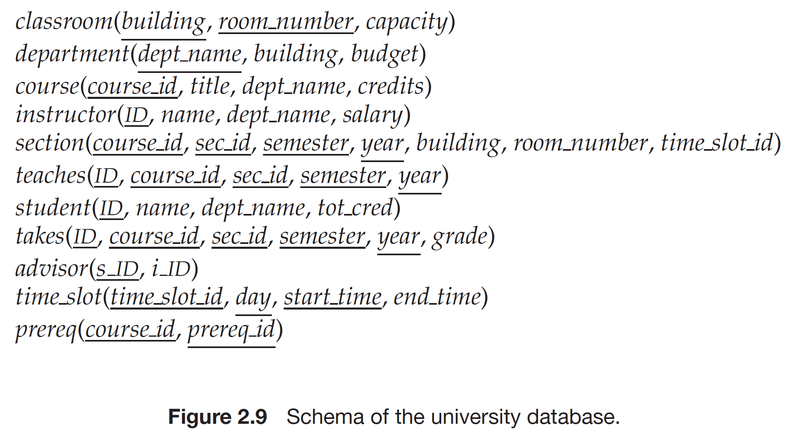
Schema Diagrams
A database schema, along with primary key and foreign key dependencies, can
be depicted by schema diagrams.

Slide 4
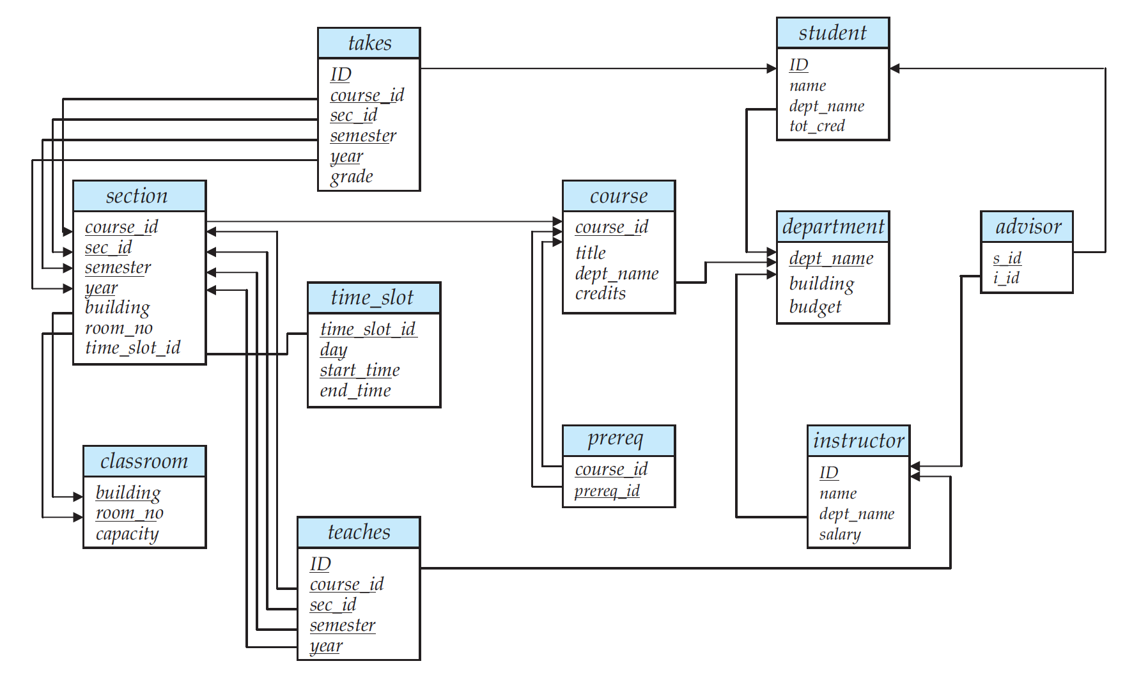
Schema Diagrams

Slide 5
Relational Query Languages
Procedural versus non-procedural, or declarative
“Pure” languages:
Relational algebra
Tuple relational calculus
Domain relational calculus

Slide 6
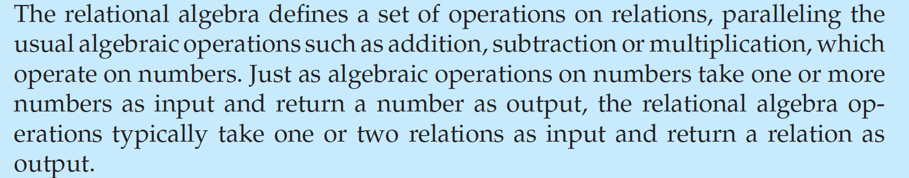
Relational Algebra
Six basic operators
select: σ
project: ∏
union: ∪
set difference: –
Cartesian product: x
rename: ρ

Slide 7
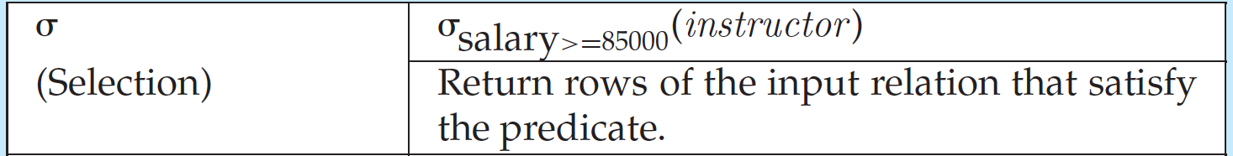
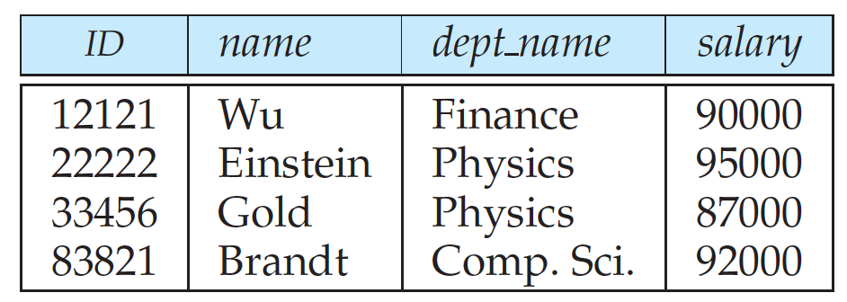
Select Operation

Slide 8
Select Operation (Cont.)
We allow comparisons using
=, ≠, >, ≥. <. ≤
in the selection predicate.
We can combine several predicates into a larger predicate by using the connectives:
∧ (and), ∨ (or), ¬ (not)
Example: Find the instructors in Physics with a salary greater $90,000, we write:
σ _{dept_name=“Physics”} ∧ _{salary>90,000} (instructor)
Then select predicate may include comparisons between two attributes.
Example, find all departments whose name is the same as their building name:
σ _{dept_name=building} (department)

Slide 9
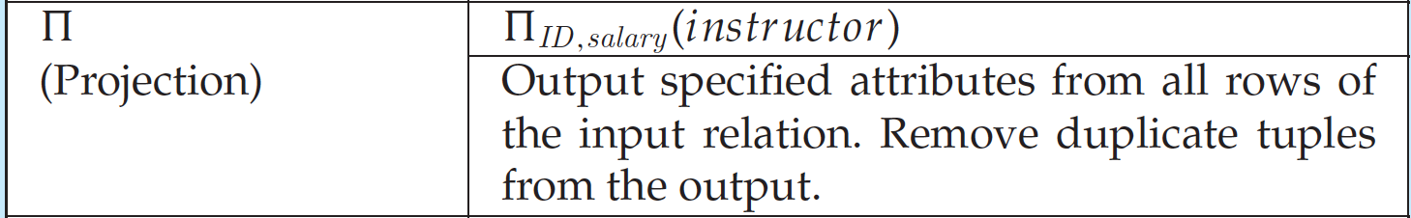
Project Operation

Slide 10
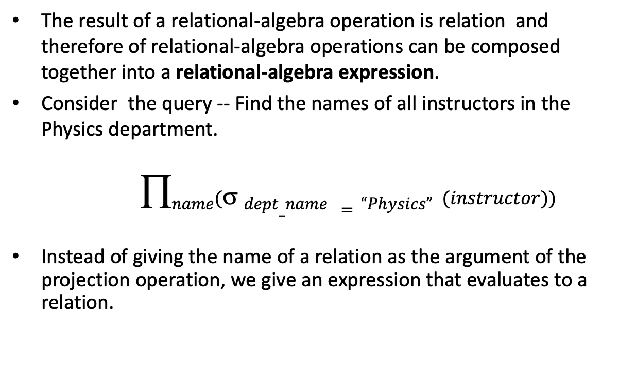
Composition of Relational Operations
The result of a relational-algebra operation is relation and therefore of relational-algebra operations can be composed together into a relational-algebra expression.
Consider the query -- Find the names of all instructors in the Physics department.
$$name( dept_name =“Physics” (instructor))$$
Instead of giving the name of a relation as the argument of the projection operation, we give an expression that evaluates to a relation.

Slide 11
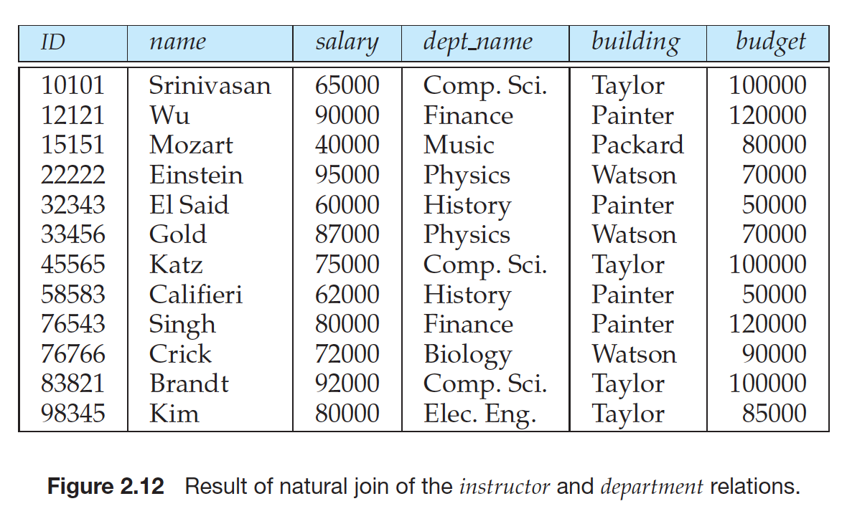
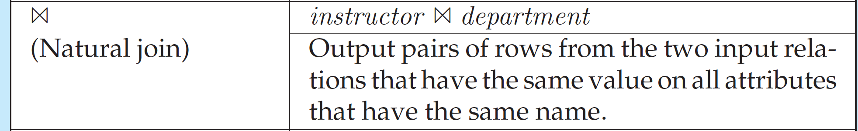
Natural Join

Slide 12
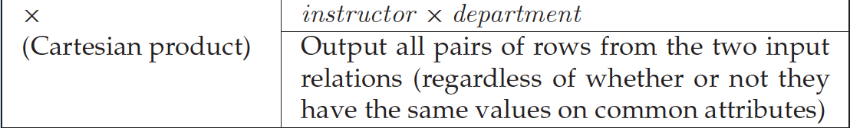
Cartesian Product

Slide 13
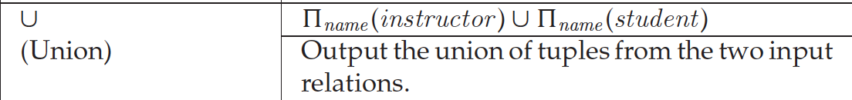
Union Operation

Slide 14
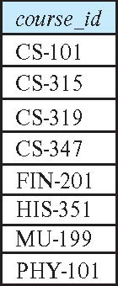
Union Operation (Cont.)
Result of: ∏_{course_id} (σ _{semester=“Fall” Λ year=2017} (section)) ∪ ∏_{course_id} (σ _{semester=“Spring” Λ year=2018} (section))

